Slide 1

Tidy Data II

Slide 2
Missing Values
Two Ways
Explicitly: Defined to Be Missing Using NA
Implicitly: Absent From Data
There is not a Uniform Way to Handle Either of These Problems
Rule: Either Convert All Explicitly Missing to Implicitly Missing or Convert All Implicitly Missing to Explicitly Missing

Slide 3
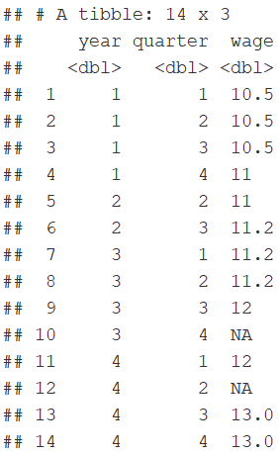
Missing Example

Slide 4
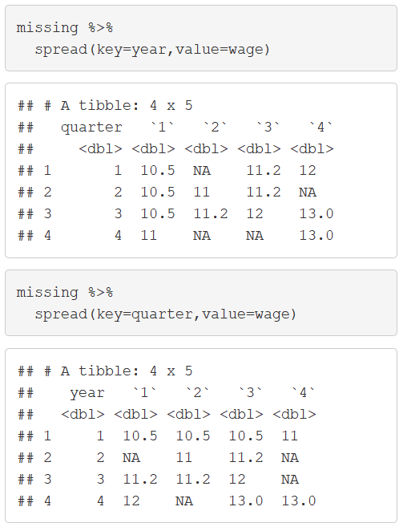
Missing Values
Notice:

Slide 5
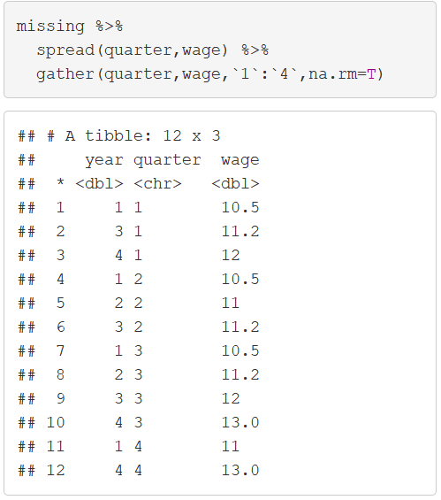
Missing Values
Explicit to Implicit

Slide 6
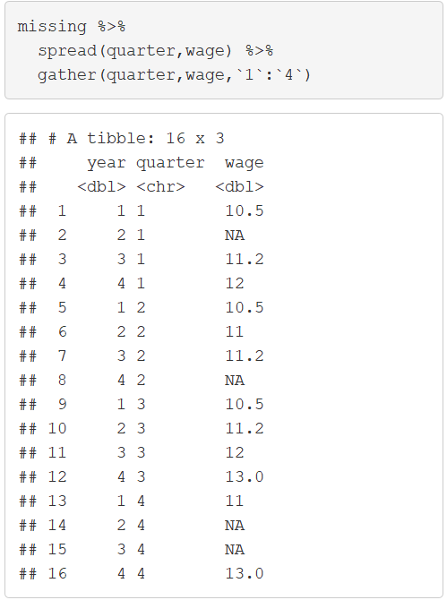
Missing Values
Implicit to Explicit

Slide 7
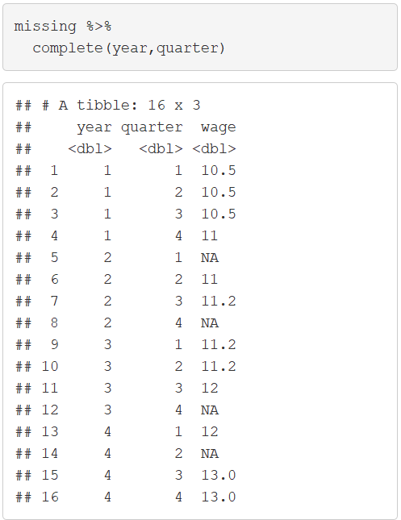
Missing Values
Complete Function

Slide 8
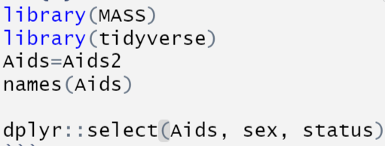
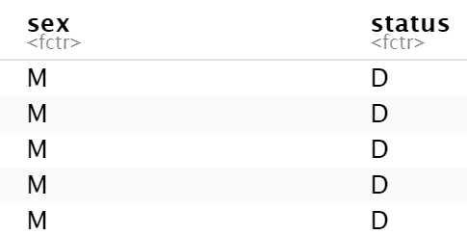
Contingency Tables
Contingency Tables
Frequencies for Combination of 2 Categorical Variables
Relative Frequencies
Summarize() + Spread()
AIDS Data from MASS Package
Data from 2,843 Patients

Slide 9
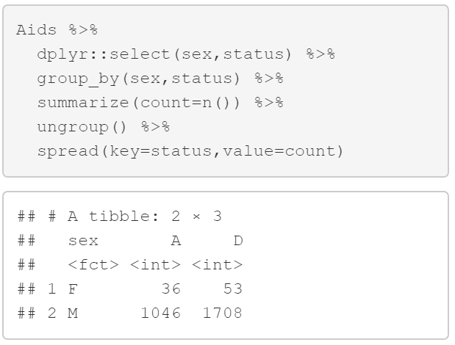
Contingency Tables
Create Table of Frequencies
Used
Check:
message=FALSE
$$36+53+1046+1708=2843$$

Slide 10
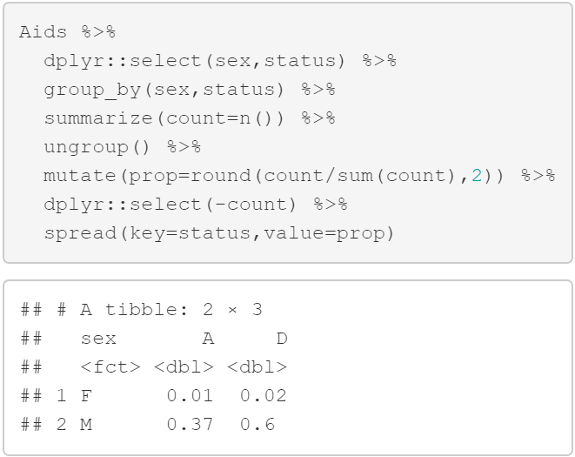
Contingency Tables
Create Table of Proportions

Slide 11
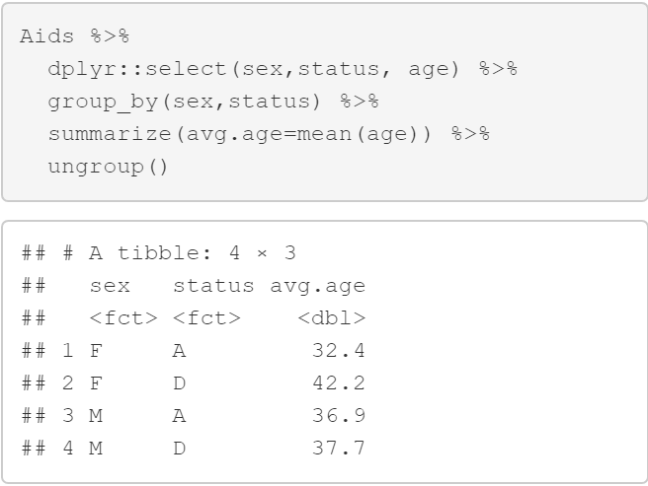
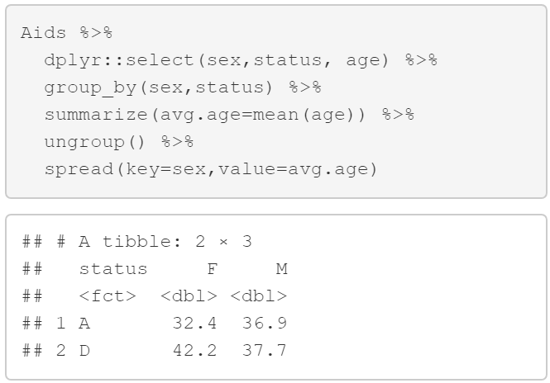
Contingency Tables
Create Table of Average Age

Slide 12
Closing
Disperse and Make Reasonable Decisions

